Slide 1
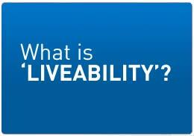
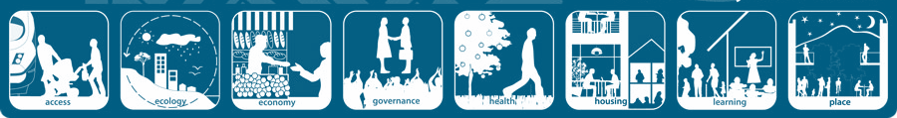
How does a city become less liveable

Slide 2
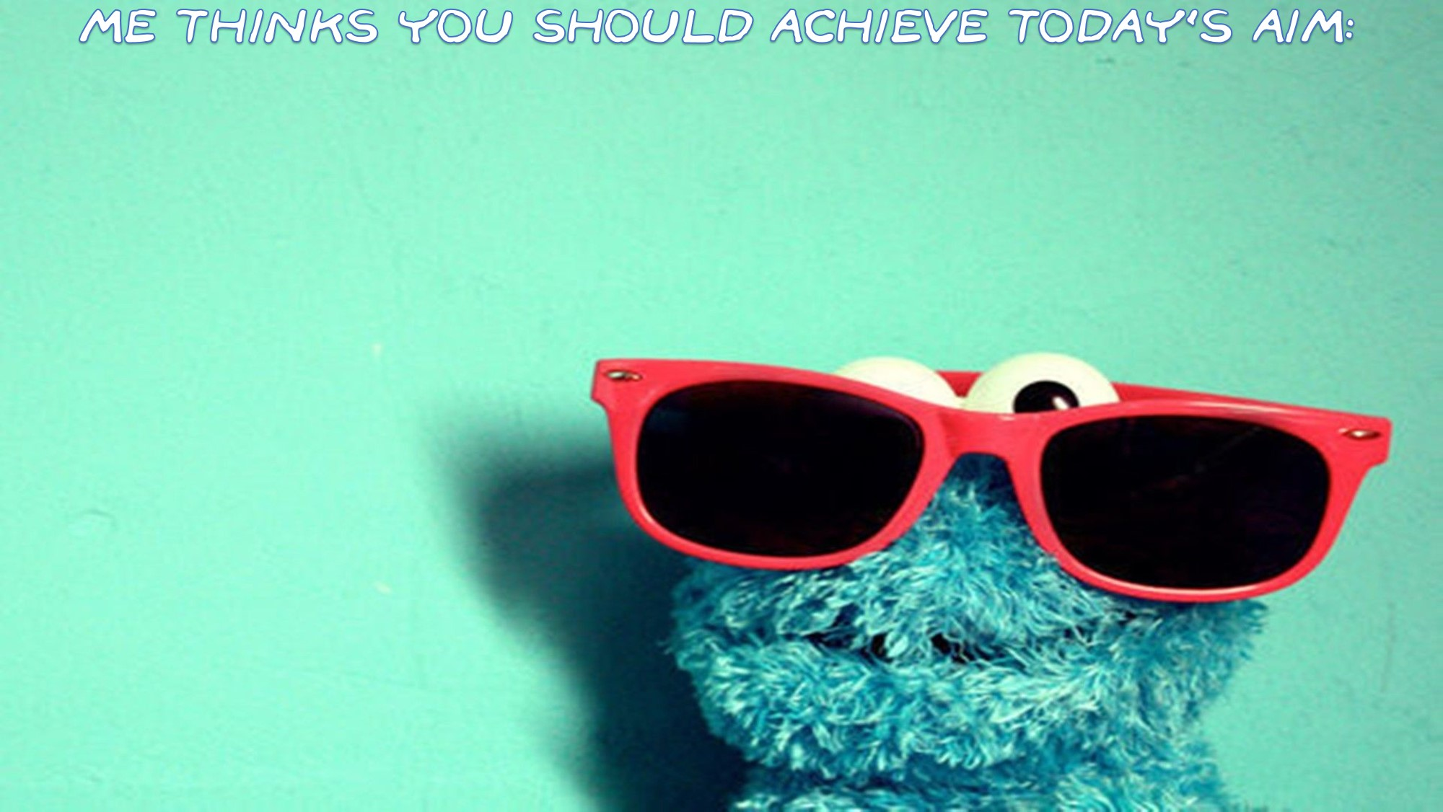
To understand how a city can become less liveable

Slide 3


Slide 4

'Liveability' - the qualities of a place (city, town, suburb, neighbourhood) that contribute to the quality of life experienced by residents and others.

Slide 5
Environmental
Cleanliness, dust, pollution, noise, air and water quality, aesthetics, climate, landscape
Social
personal security, traffic safety, community identity and pride, neighbourliness, connectedness
Cultural
historic structures, mature trees, traditional architectural styles, streetscapes, belief, traditions, backgrounds
Economic
Value of property, employment opportunities, affluence, investment
Infrastructure
streets, public transport, health, shopping centres, schools, religious institutions, parks and sporting facilities, other public facilities, communications.
Political
Wars, conflicts, terrorism, change in government, laws etc

Slide 6



Small cows eat every icecream perfectly

Slide 7



Slide 8
What can change to make a city less liveable?
Political
Infrastructure
Social
What can change?
Cultural
Economic
Environmental

Slide 9

Go to OneNote and work through activities

